Slide 1
Digital portfolio
STUDENT Name:N.nooris raihan
Register no and nmid:24134131802522012 and asanm41341324214013
Department:BSC.computer science
College/university name:deen college of arts and science/annamalai University

Slide 2
Project title
Digital portfolio

Slide 3
Agenda
Problem statement
Project overview
End users
Tools and technologies
Portfolio design and layout
Features and functionality
Results and screenshots
Conclusion
GitHub link

Slide 4
Problem statement
Could you please clarify what you mean by “Program statement main content”? Are you referring to:
The main content of a program statement in general (e.g., in programming)?
A problem statement for a programming task or competition?
A project/program proposal (e.g., in academics, business, or NGOs)?
Something else entirely?
Let me know the context, and I’ll tailor the answer accordingly.

Slide 5
Project overview
A digital portfolio is an online collection of an individual’s work, achievements, skills, and experiences, presented in a structured and professional format. It serves as a dynamic resume, personal brand showcase, and evidence of growth.

Slide 6
Who are the end users
1. Employers – to check skills and hire candidates 2. Colleges/Universities – for admissions and scholarships. 3. Clients – to see past work and give projects. 4. Teachers – to assess student progress. 5. Peers – for collaboration and feedback.

Slide 7
Tools and technologies
Tools Used: (List any software, hardware, or platforms used in the project.)
Programming Languages (if any): (Mention any coding languages used.)
Technologies/Frameworks: (Any special technologies, libraries, or frameworks used.)
Why These Were Chosen: (Brief reason why you chose these tools or technologies

Slide 8
Portfolio design and layout
The portfolio design features a clean and user-friendly layout with easy navigation. It includes sections like About Me, Projects, Skills, and Contact. A consistent color scheme and typography are used to maintain a professional look, while visuals and icons enhance readability and engagement across all devices.

Slide 9
Features and functionality
User-friendly interface
Secure login and authentication
Responsive design (mobile and desktop)
Real-time data updates
Easy navigation between sections
Interactive elements (buttons, forms, etc.)
Fast loading speed
Error handling and feedback messages

Slide 10
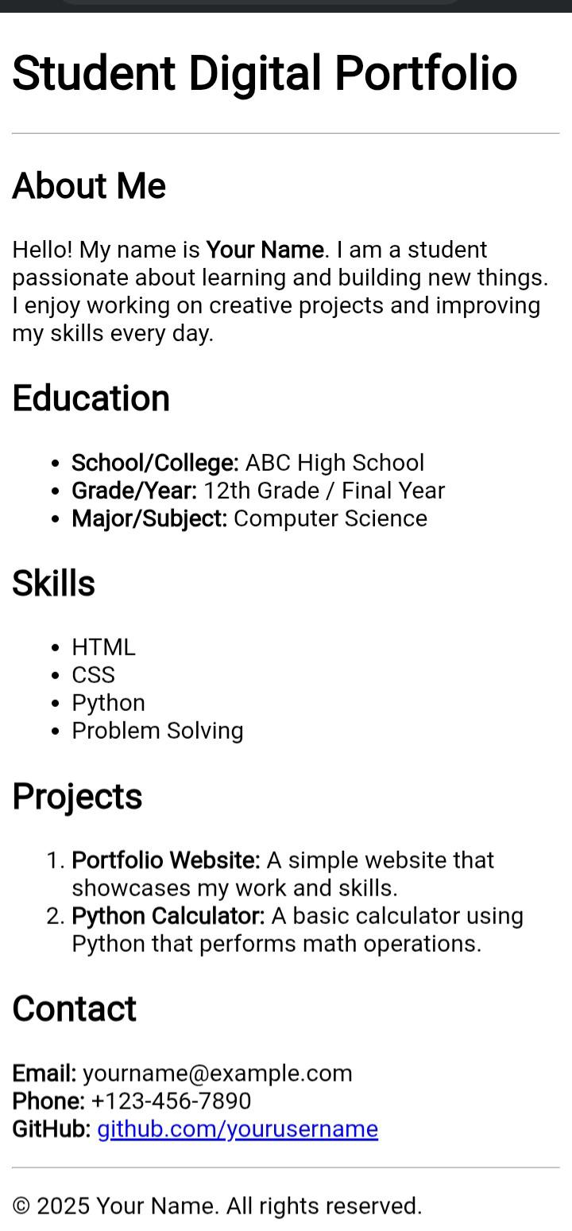
Results and screenshots

Slide 11
Conclusion
In conclusion, this digital portfolio effectively showcases my skills, projects, and achievements in a professional and organized manner. It provides an easy-to-navigate platform for viewers to explore my work and learn more about my background. This portfolio will continue to grow as I gain more experience and update it with new projects and accomplishments.

Slide 12
GitHub link
https://github.com/dccs24raihan-gif/Raihan-TNSDC-FWD-DP.git

